Slide 1

Exploration Through Augmented and Virtual Reality
Team Members:
Rohini Yedelli
Vaibhav Goyal
Radhika Raghuwanshi
Mentor: Mrs. Smita Jangale

Slide 2
Introduction to Virtual Reality & Augmented Reality
Virtual Reality (VR) is a computer simulated reality which replicates the real world and simulates the users physical presence in that computer generated world while in
Augmented Reality (AR) the user is present in the physical real world and the computer generated objects are superimposed upon or composited with the real world.

Slide 3
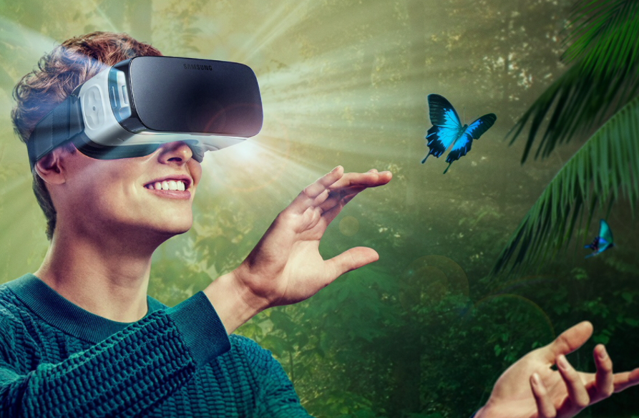
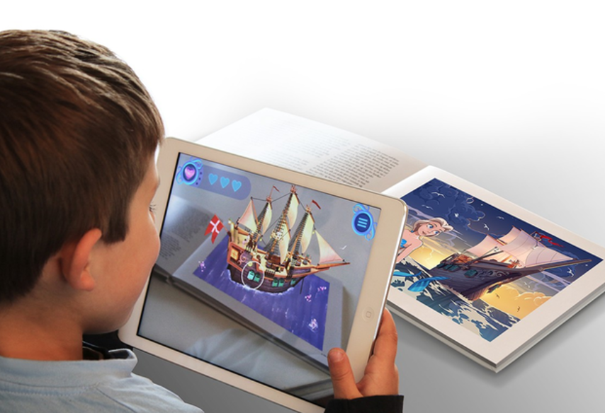

Slide 4

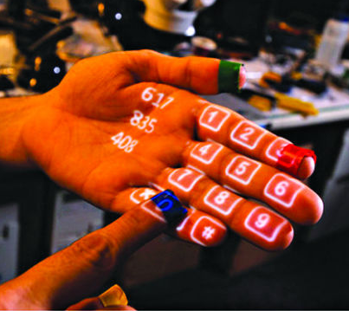
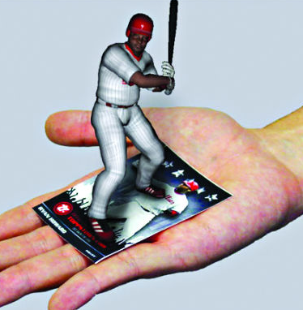
Types of Augmented Reality
Projection Based AR
Recognition Based AR

Slide 5
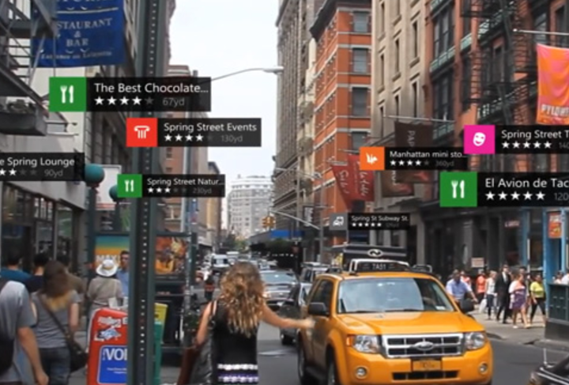
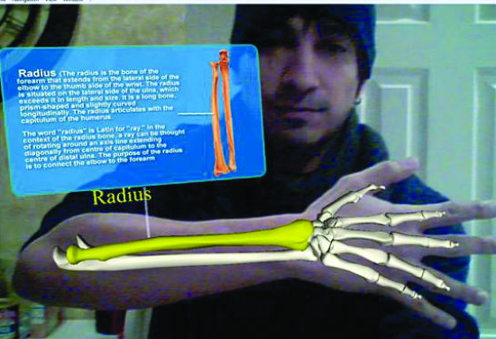
Location Based AR
Superimposition Based AR

Slide 6

Project Objective
The objective of this project is to find how Augmented Reality and Virtual Reality can be used in the field of Education. It will provide students a whole new look towards studying using Virtual and Augmented Reality.

Slide 7
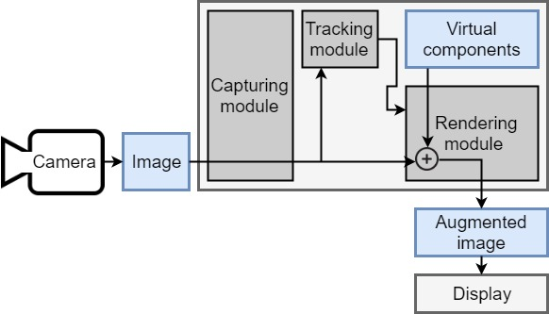
Working of Marker Based AR System

Slide 8

Hardware/Software Requirements
Unity3D (Personal edition)
Vuforia
C#
VR Headset
Smartphone with Gyroscope and Magnetometer
sensor

Slide 9
Process
Vuforia
Unity
Exploration(Android Application)

Slide 10

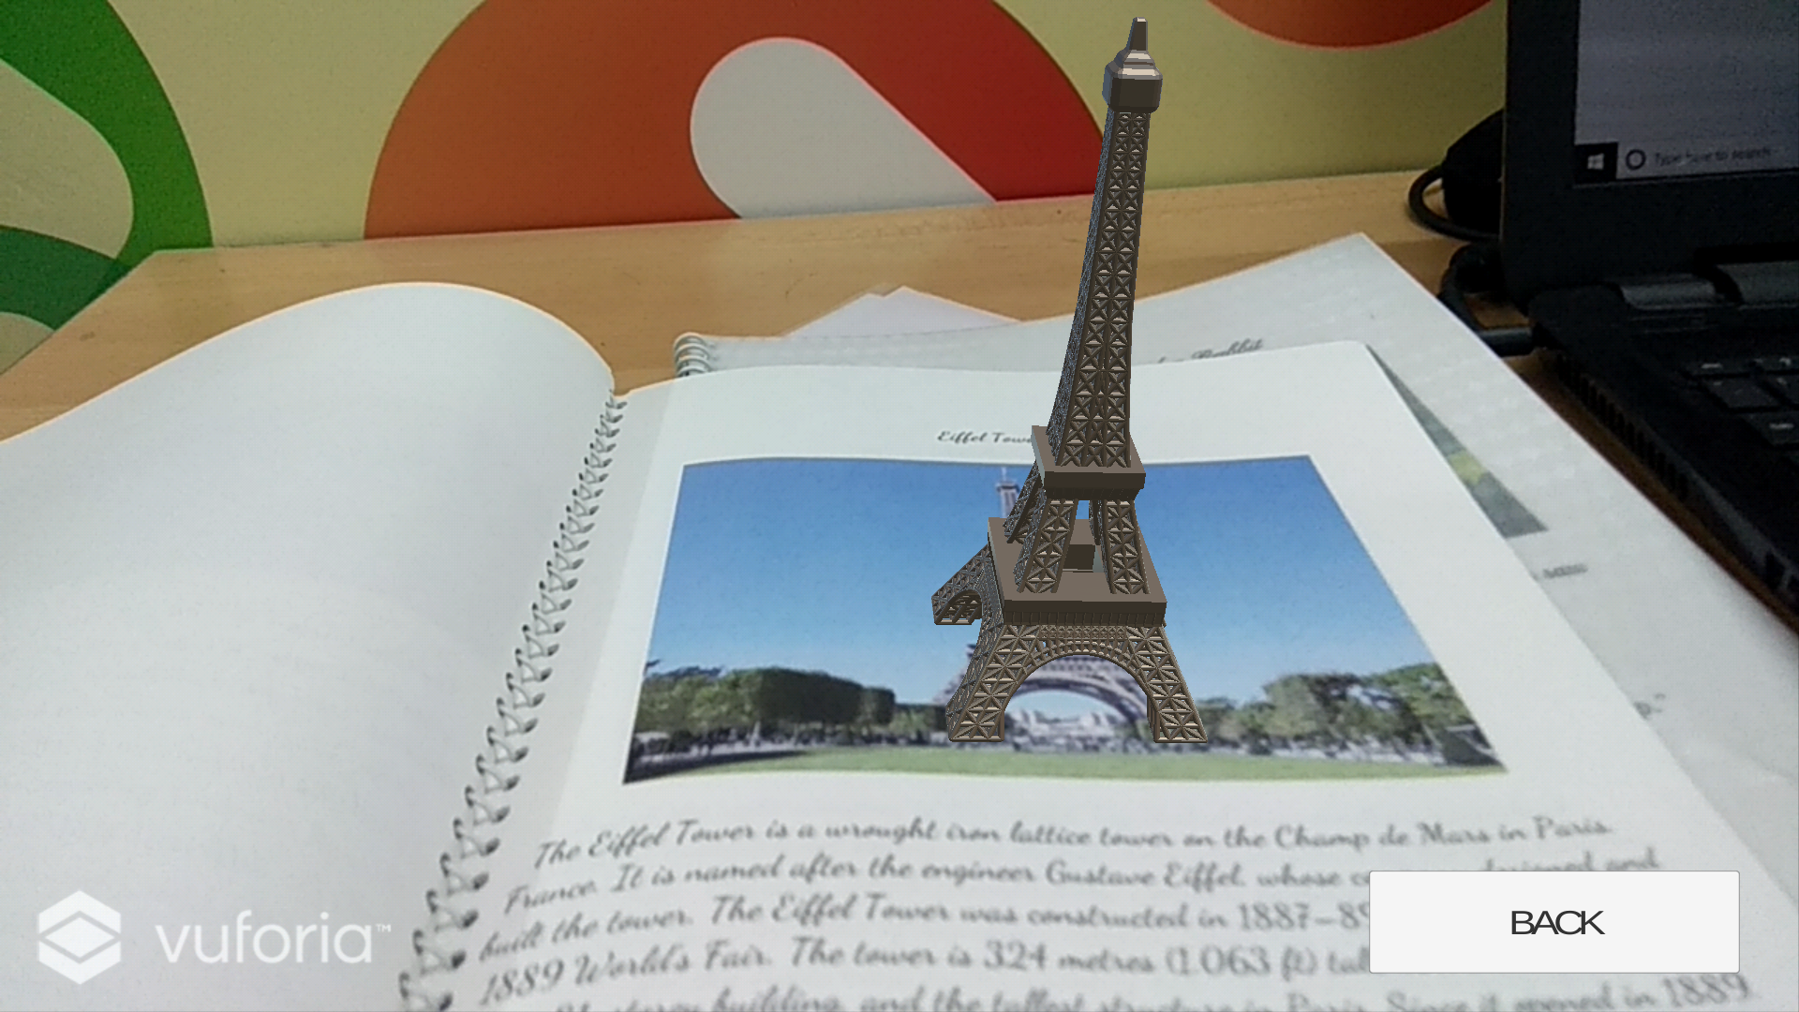
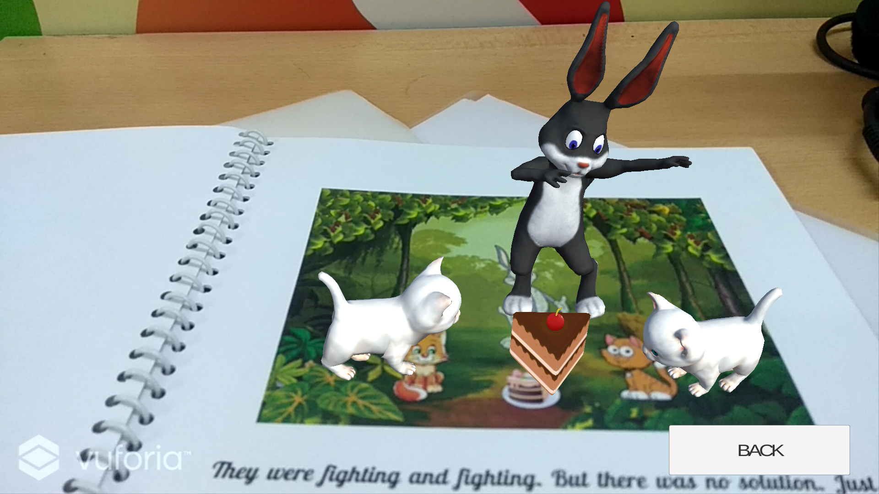
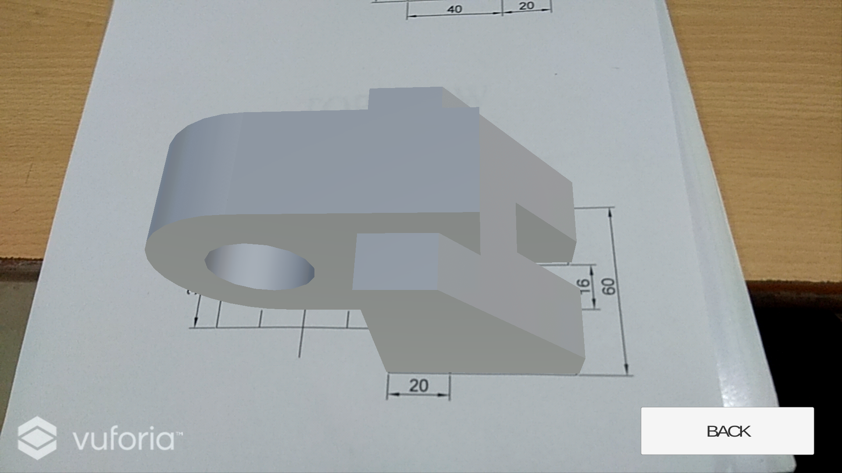
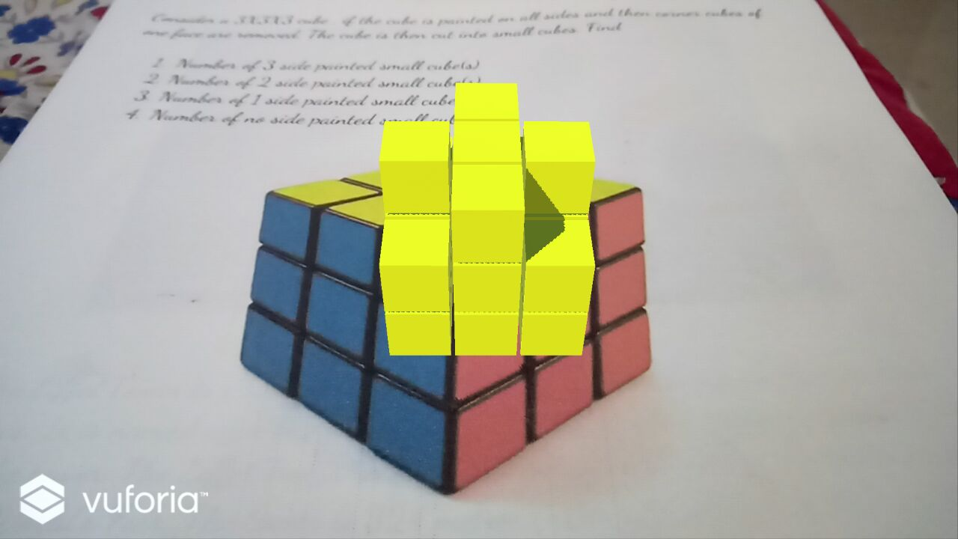
Project Outcomes

Slide 11
THANK YOU

